Slide 1



Facilitators notes:
With thanks to Joe Paull, Director of Revenue at The Lowry Hotel for sharing this resource.
The Lowry Hotel has been partnered with The Lowry Academy school in Salford since 2021, following the Hospitality Connect programme of activities to enhance the curriculum and offer meaningful group visits to the workplace.
This PowerPoint presentation was used by Joe in Feb24 to explain the brand, and the career of an event planner / manager. Joe used examples of corporate and private clients requests over the years and helped the students understand the job role and expectations.
The intended outcome of the session was to prepare students for the forthcoming GCSE Food Tech exams, where there is often an event management question. The teacher supplied practice questions for students to complete in pairs with Joe’s support & student feedback was very positive.
This resource is intended to be used as a ‘starter for 10’ for other Hospitality Connect Ambassadors to use in a classroom environment. Please personalise this presentation & collaborate with your teacher to meet learning objectives.

Slide 2
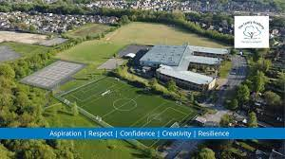
The Lowry Academy
The Lowry Hotel

Slide 3
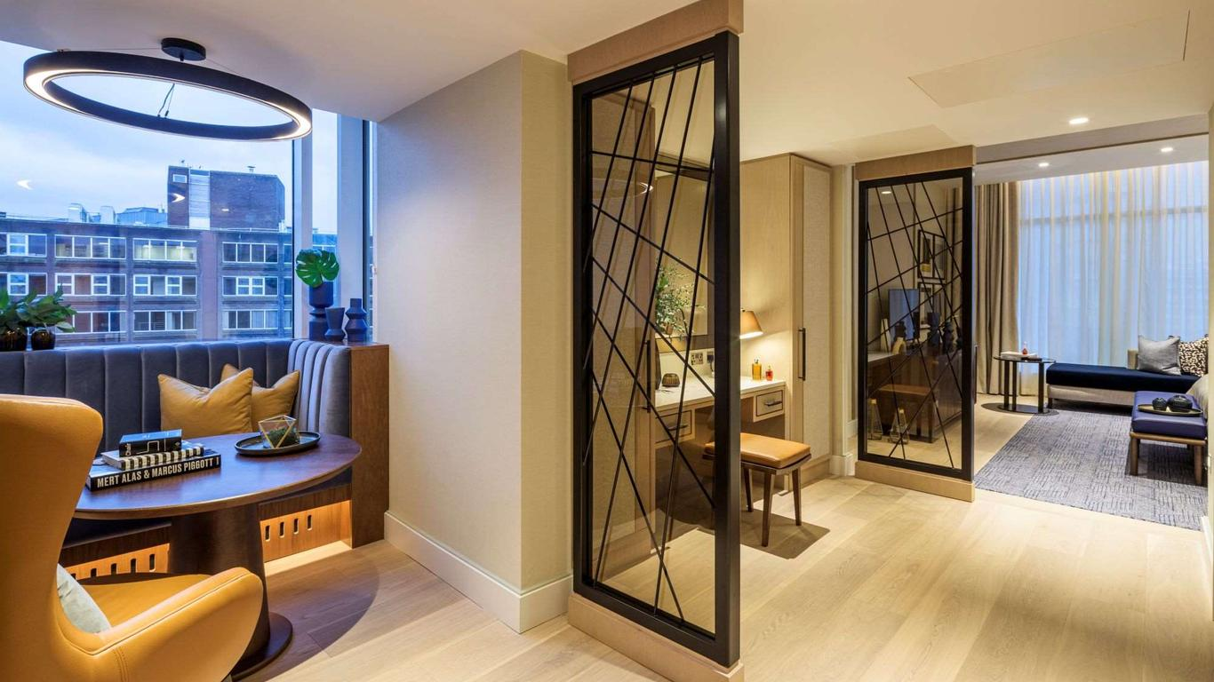
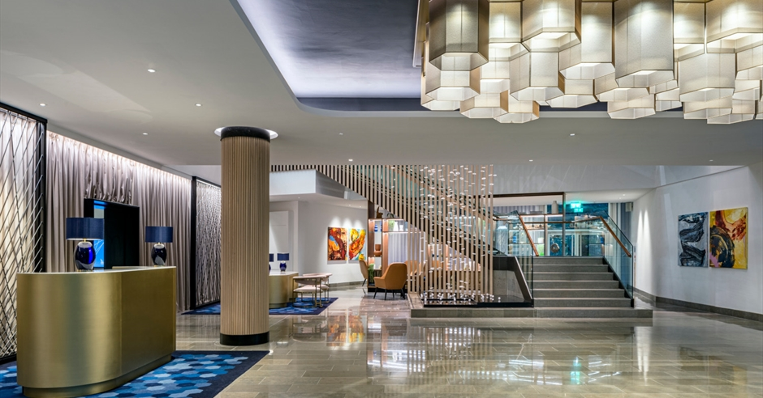
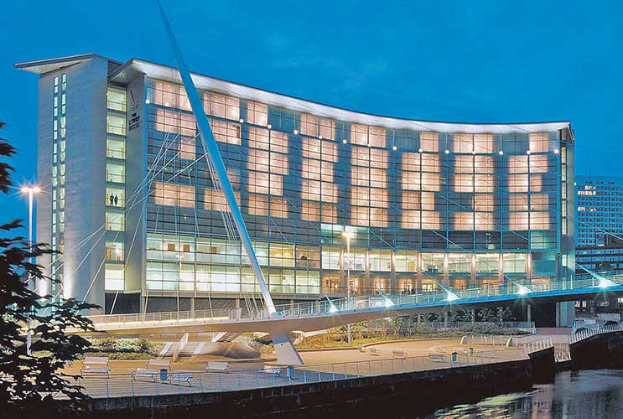
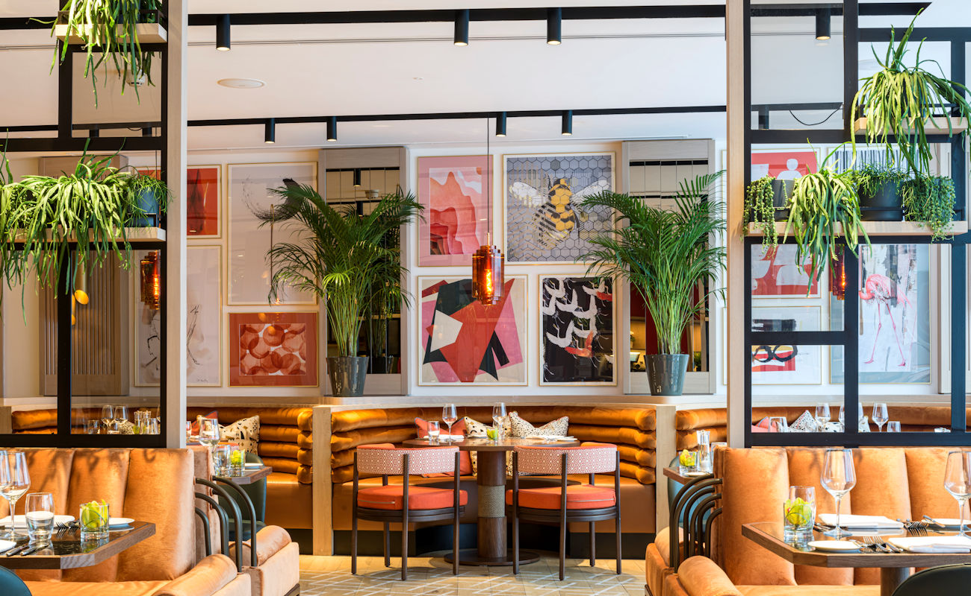
The Lowry Hotel
Iconic – Individual- Intuitive
Manchester’s first 5* Hotel
165 Bedrooms
  1 Presidential Suite
  11 Suites
New £1m Refurbished Spa, RE:TREAT
2 AA Rosette Restaurant, The River Restaurant
Rooms up to £4,500

Slide 4

Fancy a career as an Event Planner?
Pros –
Variety
Meeting Interesting People
Teamwork
Good Job Prospects
Potential to own your Own Business
It can be such fun
Cons –
Can be Long Hours
Stressfull
Dealing with Difficult People
Experienced Preferred

Slide 5
Task
Create your event. . .
We would like you, in teams, to create a “Party” style event for a Birthday Celebration.
The client has asked for –
100 people, food and dancing and has mentioned that some people may travel some distance for the event and may need accommodation. Client also mentions that several of the guests will be elderly, and some will be children.
Think carefully about what you need to consider and how you can meet the needs of your clients, how to pick a venue, what does this venue have to offer? Can it meet your criteria in terms of the brief you have had from your client.

Slide 6
Have you considered…
The Venue –
Can it accommodate the numbers?
Does it have bedrooms?
What about the catering?
Are these type of events successful at this property? How can you check?
Can the venue offer all that the client has requested?
Can the venue accommodate for both the elderly and children?
What assistance does the Venue offer?

