Slide 1




With thanks to Sheraton Grand Hotel & Spa Edinburgh – for developing this workshop and sharing these slides for the benefit of other Hospitality Connect Ambassadors.
Sheraton Grand are in a partnership with Portobello High School in Edinburgh and working together to showcase the hospitality sector within the curriculum. The school have enjoyed visits to the property and have experienced careers sessions such as this one, to help prepare students for the world of work. Their partnership is supported by the DYW Edinburgh, Midlothian & East Lothian team.
The slides that follow are an ‘Interview Skills Workshop’ – and can be used and adapted by other Ambassadors volunteering for Hospitality Connect when delivering sessions in schools.

Slide 2



Interview Skills
Workshop

Slide 3
Todays Agenda
  Getting the Interview
  How to prep your CV
  Cover Letters
  Dress for the Occasion
  The Interview
  STAR
  Communication

Slide 4

Getting the interview
  Search online using key words
  Speak to friends & family
  Think about what interests you?
  Personalise your CV
Notes:
Search online using key words – are you looking in the right location? Can you get there and back for shift pattern times?
Speak to friends and family – this is how I got my first job. I was 16 and having dinner with my mam in our local restaurant. My mam knew the owner and told him I was looking for a job. Thought nothing of it and one week later he rang the house phone and asked if I was free for the summer
What interests you? What would you be able to show already in your CV? For example gym assistant – do you play sports teams already? Have you done any underage coaching or helped out in camps?
Update your CV for the role – I have read so many CV’s where they say how they are looking to “start their career in X” but have applied for a job in the Y industry. It is an automatic reject because it shows lack of attention to detail and lack of interest in the role itself. We want an engaged candidate that will stay with us.

Slide 5
How to prep your
CV

Slide 6
What is in a great CV?
Name
Contact Details
Awards
Personal Statement
Work Experience
One Page
Volunteer Experience
Notes:
Tell me a few details that would be great in a CV – ask the class to shout out and transition into the words

Slide 7
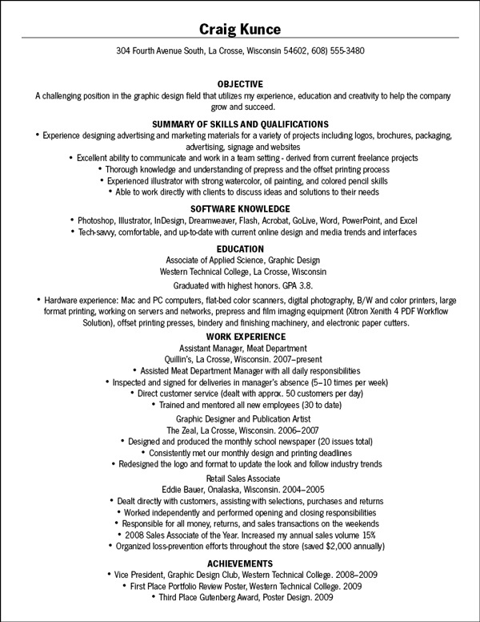
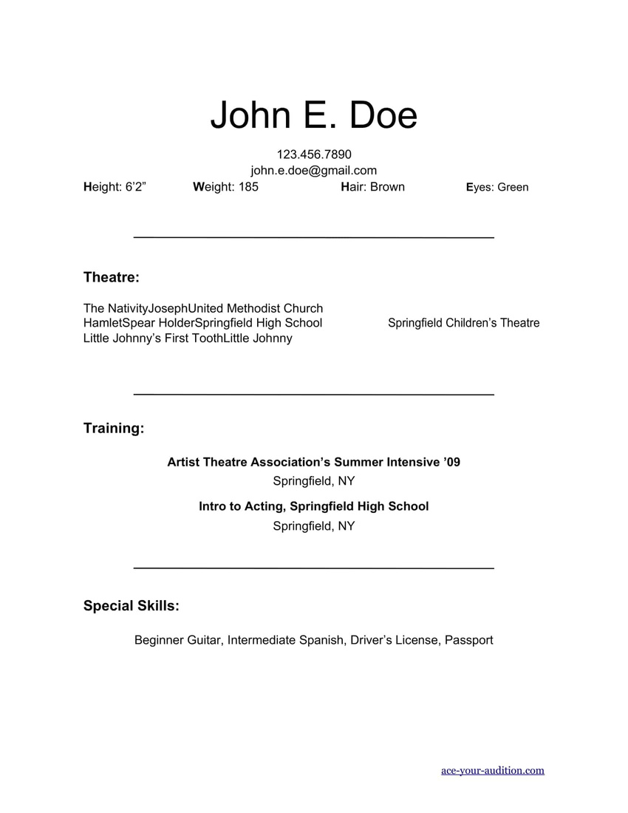

CV Examples
What do we think?
Is the info nicely laid out?
Cluttered?
Relevant information?

Slide 8

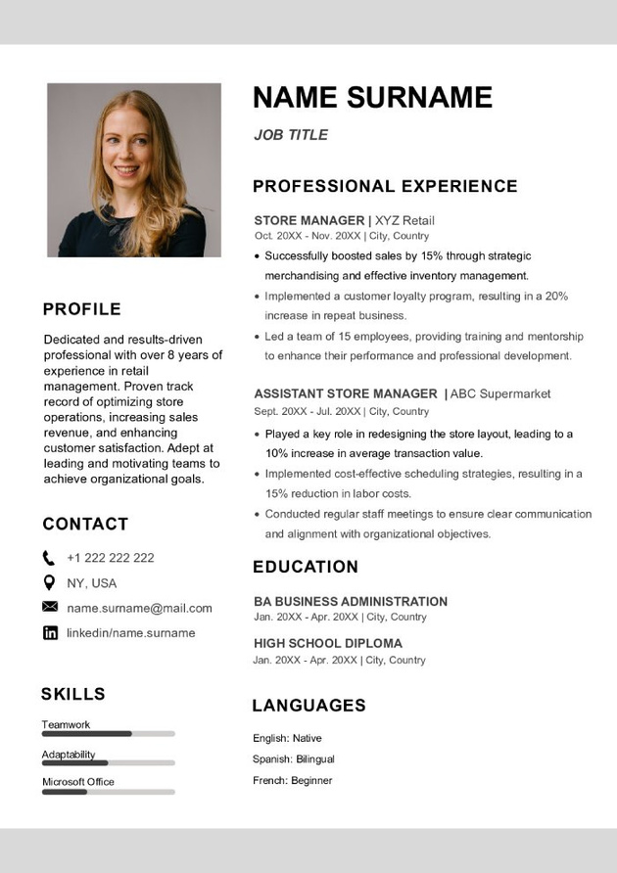
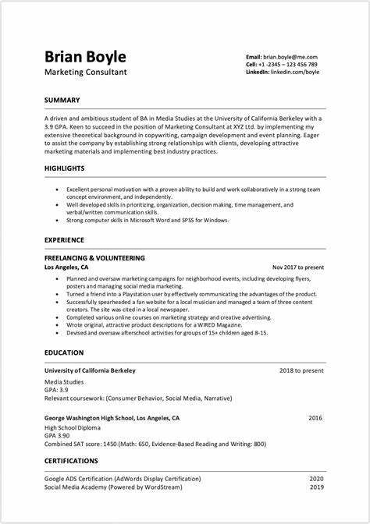
CV Examples
What do we think?
Is the info nicely laid out?
Engaging to look at?
Relevant information?
Notes:
Which example would you be more likely to invite for interview?

Slide 9

What is a Personal Statement?
A short blurb about who you are and what type of role you are looking for

Slide 10

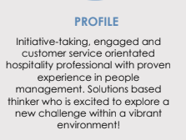
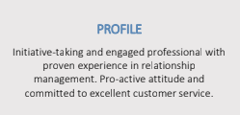
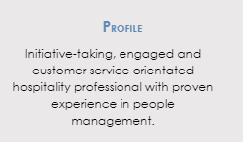
Your personal statement changes over time..
Notes:
Expect to change your personal statement as your grow and as the jobs you are applying for change in the qualities they are looking for.
My first personal statement… says experienced but in reality, I had only worked 2-3 5* hotels at this stage but thought I knew everything!
The next one was where I had gained strong experience with teams – lets showcase that. And lets tell them what type of environment I thrive in.
Having gained management experience, I focused on this and honed in on what I do best in Front Office Manager roles
Moving from customer facing to a HR role, the people management skills I learned while doing other roles is what was an excellent translatable skill and crucial to HR.

Slide 11
Activity: Write your own personal statement
What would you like to share? What key skills do you already have?
What are you looking for?
Do you have attention to detail? Are you energetic? Are you driven? Do you have a strong work ethic?

Slide 12


Cover Letters
Must be tailored to the role you are applying for
They show that you are serious about the opportunity
Helps explain why you are the right person for the job
Notes:
Can be a negative if not tailored to the role as highlights a lack of interest/attention

Slide 13
Dress for the Occasion
Notes:
Remember we dress our perfect associate?

Slide 14
Examples of “What to do”
Clean Hair
Professional
Jewellery
Subtle Makeup
Smile
Blazers and Trousers
Smart Dress
Groomed Facial Hair

Slide 15

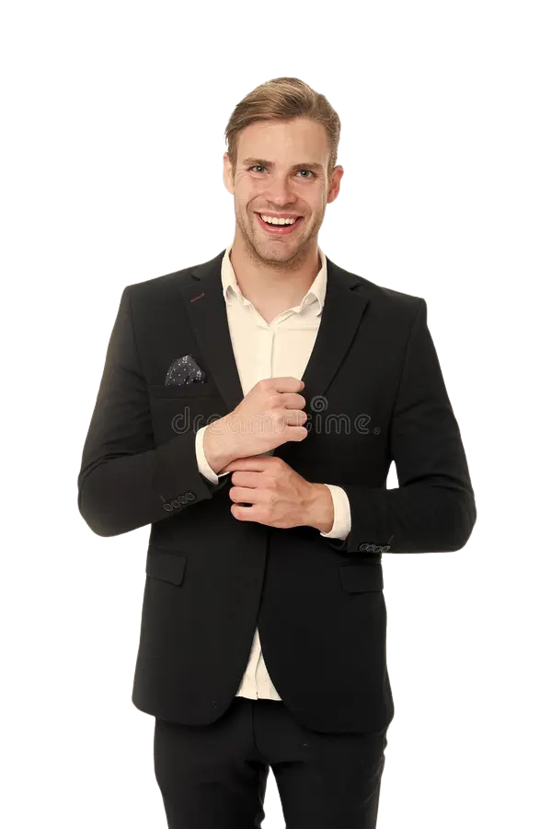
What do we think?
Notes:
Front Office Receptionist – would this be an appropriate attire? Would you see a receptionist getting a role turning up in ripped jeasn?
Picture two – smartly dressed, dressed for the role. Do you think would be more likely to get the role? Better first impression?

Slide 16
The Interview

Slide 17
Common Opening Questions
A great opportunity to describe yourself and build a relationship with the interview. These would be open ended questions to take the opportunity to speak about your background, what interests you and why this role would be suitable for you.
Examples
Tell me about yourself?
Why are you applying for this role?
What are your strengths and weaknesses?
Notes:
Tell me about yourself role play with Mercedes. Good & bad example. Example role, commis chef

Slide 18
Role Play
Tell me about yourself?
Why are you applying for this role?
What are your strengths and weaknesses?
Each person to write prepare their own answers and then partner up with the person next to them to share
Notes:
Tell me about yourself role play with Mercedes. Good & bad example. Example role, commis chef

Slide 19
Before the Interview
Prepare by researching the company and the role!
Bring questions to ask the interviewer!
Practice frequently questions!

Slide 20
Competency Based Interviews/STAR Questions
Competency-based interviews use questions to target how you’ve used specific skills in past jobs and how you approach problems and tasks.
The idea behind this style of interview is that your existing experience is an indicator of how you’ll be in the role you’re applying for.
These are structured and each answer is scored.

Slide 21
STAR Technique
•SITUATION : Set the scene. Where and when did this take place? Are there any project details you can provide, like who you were working for?
•TASK: Explain what your task and responsibility was. Make sure to focus on what you were specifically assigned to, not your team. Use “I” language.
•ACTION: This is the most important part. Describe how you handled the situation and conquered the problem. You're trying to show them how you assessed the situation and stayed proactive.
•RESULT:Close the story by stating the outcome of your actions and what you learned. This is a good time to quantify the impact you had with statistics or other evidence.

Slide 22
STAR Example

Slide 23

‘Eleanor, describe to us a time when you have led a team…’

Slide 24

Situation:
“I was working at Waterstones as a sales assistant during the Christmas
holidays while the store was going through a rebrand.”

Slide 25
Task:
“•As the store steadily became busier, I moved over to the children’s department. My job was to ensure the smooth running of the rebrand while also providing good customer service.”

Slide 26
Action:
“•To support the rebranding in the children’s department, I had regular meetings with the store manager. This meant I was aware of when new stands or shelves were coming in and was able to manage my time effectively to help set these up in time for the reopening.”

Slide 27
Results:
“We achieved record sales during the Christmas period, a 50% increase on last year, while the rebrand continued with no issues. I was presented with an ‘Employee of the Quarter’ award in recognition of how I managed the team”

Slide 28
STAR Tips
Pause and gather your thoughts
Be Specific
Give Context
Don’t Forget Results!

Slide 29
Non Verbal Communication
How much of our communication is non verbal?
93%

Slide 30
Non Verbal Cues
Posture
Eye contact
Smile
Handshake

Slide 31
Non Verbal Cues
Posture
Eye contact
Smile
Handshake

Slide 32


Activity: Handshakes
Make 2 circles facing each other

Slide 33
Questions to Ask
Why do we ask questions at the end?
To find out if the role is a fit for us as well as the employer – it is you interviewing them also

Slide 34
Questions to Ask
What are the next steps?
What is the shift pattern/schedule?
What are the expectations within the first month, three months, six months?

Slide 35
Practice Time!
Pick a job to interview for!
1) Pool Attendant
2) Kitchen Porter
3) Food & Beverage Expert

Slide 36

Question 1
Why are you
interested
in this position?

Slide 37

Question 2
What are your
strengths?

Slide 38

Question 3
Pick a question from
the slips!

Slide 39
What do you think
What did you find easy?
What did you find difficult?
Anything surprising?

Slide 40
After the interview
Send a thank you email!
Reflect on what went well
Consider any answers you would change

Slide 41
Any Questions?

