Slide 1




Sustainability:
ESG info & insights
Facilitator guide:
This resource may be used by an educator or Hospitality Connect Ambassador. We recommend that this content is used within a Business Studies and / or Geography class in order to address sustainability measures within hospitality as a spotlight sector. You are welcome to adapt this information to match your curriculum unit requirements.
This resource was kindly compiled by Simon Catterick, Founder and Chief Executive Officer of mission-netzero.co.uk You may also find the following links useful:
Green tourism awards: Home - Green Tourism Net Zero Go (UK Local Authorities): Home - Net Zero Go
Nestle ‘road to net zero’: Our Net Zero roadmap | Nestlé UK & Ireland

Slide 2



The Case for ESG Action in Manchester’s Hotel Sector
Addressing Environmental and Social Priorities to Protect Value and Meet Guest Expectations
What is ESG? Environmental, Social, and Governance (ESG) – a framework for managing a hotel’s impacts on people, planet, and ethical business practices.
Why ESG Matters Now: Key UK Hospitality Facts
Energy Use
Hotels account for around 3% of UK commercial energy consumption (Carbon Trust)
Energy is typically the second largest operating cost after staffing
Greater Manchester has set a target to become a zero-carbon city-region by 2038, which means hotels must significantly cut emissions to align with this carbon neutrality goal.
Taking action: installing efficient heating, LED lighting, and smart controls can cut energy bills by up to 30%, boosting net operating income
Differentiation: guests increasingly choose hotels with clear carbon-reduction measures; 82% of travellers say sustainable travel is important to them (Google, 2023)
Water Use
Average hotel guest consumes 180–300 litres of water per night (DEFRA)
Leaks and outdated fittings can waste up to 30% of water use
Taking action: installing low-flow showers, taps, and monitoring leaks reduces water bills and sewerage charges
Differentiation: sustainability-minded guests and corporate bookers value water stewardship credentials; 65% of travellers feel better staying in certified sustainable properties (Booking.com, 2024)
Waste
UK hotels generate nearly 290,000 tonnes of waste annually, including around 79,000 tonnes of food waste (WRAP)
Average waste production is around 1kg per guest per night
Disposal costs are rising due to landfill taxes
Taking action: food waste reduction
and better recycling lowers disposal costs and protects margins
Differentiation: demonstrating waste reduction aligns with guest expectations and brand sustainability messaging;
59% of travellers want to filter for certified sustainable stays when booking (Booking.com, 2024)
Social Sustainability
Hospitality is a major Manchester employer, supporting 30,000+ local jobs (Marketing Manchester)
ESG initiatives promote fair pay, skills development, and community engagement – vital for attracting and retaining talent
Manchester’s £1-per-room City Visitor Charge signals rising stakeholder expectations for hospitality to contribute to the local economy and community
Taking action: investing in fair wages, local partnerships, and staff training boosts retention and cuts recruitment costs
Differentiation: a socially responsible culture builds loyalty among guests, staff, and the community; 82% of travellers value positive social impact in sustainable travel (Google, 2023)
Manchester’s hospitality community can lead the way by embedding ESG strategies that protect business resilience, enhance guest trust, and support local climate and social ambitions.
These slides were presented at Mcr Hoteliers Assoc meeting in July 2025.

Slide 3
Why Hotel Managers Need an ESG Strategy
Meeting the Expectations of Owners, Investors, Brands, Guests, Teams, and Communities
Manchester’s hotel sector must go beyond token sustainability—here’s why informed ESG strategy matters:
Owners & Investors
Protect asset values and manage climate/social risks by using credible programmes & certifications like EPC’s, BREEAM, Green Tourism and Green Key
Future-proof assets from tightening standards, such as Greater Manchester’s 2038 net‑zero target
“Sustainable hotels achieve up to 11% higher asset valuations compared to their peers.” (JLL, 2023)
Brands
(Global & Independent)
Require reputable third-party certifications aligned with proprietary ESG programmes eg: Hiltons – Travel With Purpose scheme, for consistent, scalable ESG delivery
Demand transparent ESG reporting aligned to recognised frameworks and KPIs
Corporate Bookers (RFPs)
According to Booking.com, 76% of travellers intend to travel more sustainably, and 45% find sustainable accommodations more appealing – driving corporate RFPs to prioritise hotels with credible ESG credentials
Industry specific third-party certification provides a clear advantage in competitive RFPs
Guests & Leisure Market
Travellers increasingly seek genuine ESG credentials – not greenwashing. 65% say they'd feel better staying in a sustainably certified property, and 59% want to filter for certified stays when booking
Transparent ESG practices and certifications build trust and loyalty among eco-conscious guests
Teams & Communities
ESG leadership attracts and retains talent in a competitive jobs market
Engagement with local sustainability supports community goodwill and inclusive growth in Manchester
Example in Action: Treehouse Hotel Manchester
Actively pursuing BREEAM ‘Very Good’ for its building standard and updating TM44 and EPC certifications
Partnering with Mission : Net Zero to pursue Green Tourism & Green Key operational certification
Demonstrates strategic alignment of sustainable building and operations – enhancing credibility, stakeholder confidence, and competitive edge in Manchester’s hospitality market.

Slide 4




























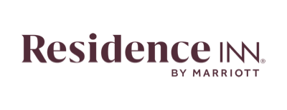






Our Hotel Sector Clients in UK & Ireland include:
Our Global Hospitality Brand Clients include:
Our Independent Hospitality Clients include:

Slide 5
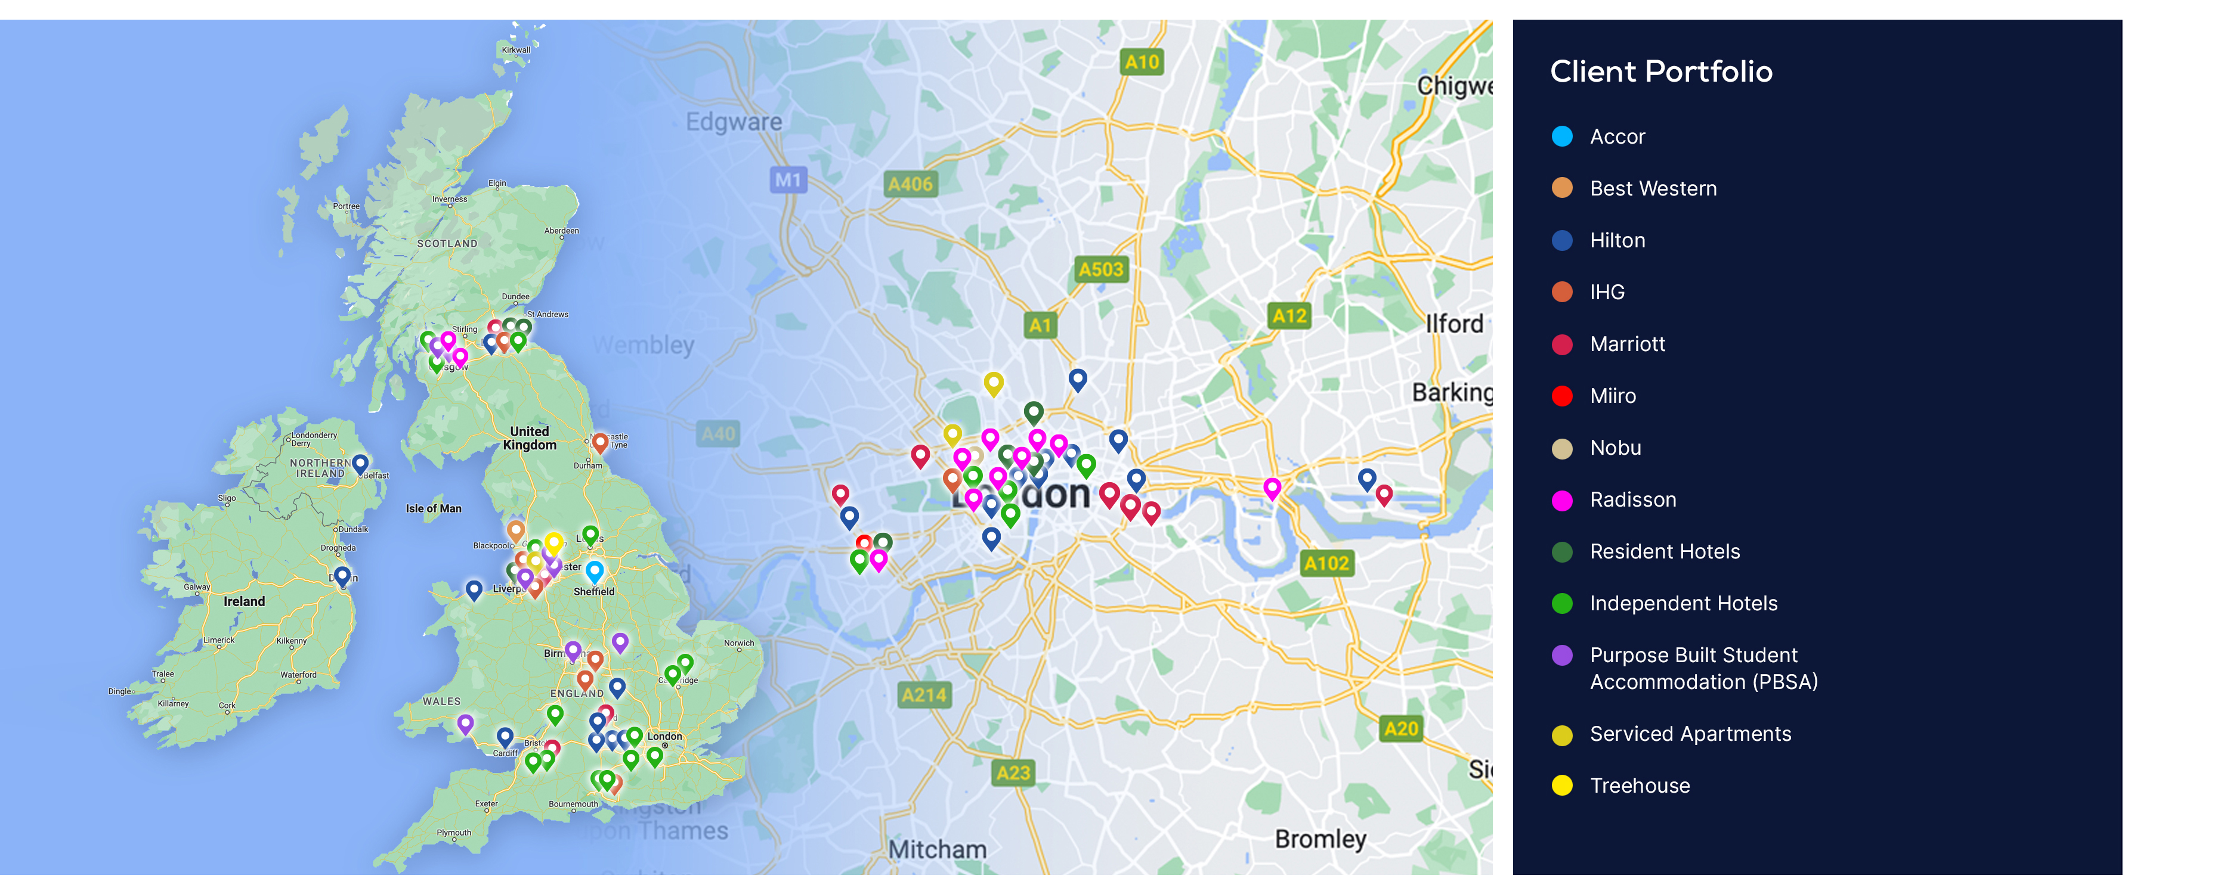
Our Hotel Sector Clients in UK & Ireland locations:
UK & Ireland – Operational Eco-Certification Clients Q2 2025

Slide 6
*we can use the epc rating image attached*
ESG Standards & Certifications: Future-Proofing Manchester’s Hotel Assets
We partner with hotel investors, owners, and operators to achieve internationally recognised certifications that mitigate risk and enhance asset value.​
An EPC assessment measures a property’s energy efficiency on a scale of A-G, with better ratings indicating lower carbon emissions. The assessment considers factors like property size, age, construction materials, lighting, ventilation, insulation, windows, and heating systems.​
A TM44 inspection is the mandatory assessment of air conditioning systems in the UK, required every 5 years for any system with a combined cooling capacity of 12 kW or more with recommendations to enhance energy efficiency and reduce carbon emissions. Required under the Energy Performance of Buildings Regulations with unlimited fines for failure to complete one.
BREEAM In-Use (for existing hotels) provides a credible framework to measure, improve, and communicate the environmental performance of an operating hotel, helping reduce costs, enhance asset value, and demonstrate ESG credentials to investors and guests.
BREEAM Refurbishment and Fit-Out (RFO) supports sustainable decision-making during hotel refurbishment projects, improving energy, water, and materials performance while protecting asset value, reducing regulatory risk, and strengthening long-term market competitiveness.
Why they’re crucial for Manchester’s hotel managers
Ensures legal compliance
Supports energy strategy, reduces operational costs
Provides verifiable action for ESG reporting and sustainability certifications
BREEAM certification demonstrates credible sustainability, protects asset value, and appeals to guests, investors, and corporate clients
Aligning EPC and TM44 recommendations with the hotel’s Property Improvement Plan (PIP) helps Manchester hotel managers efficiently plan upgrades, meet brand standards, and support the city’s 2038 zero-carbon target while protecting asset value and ensuring ESG compliance.
Protect your asset, prove your ESG, and power a zero-carbon Manchester – while meeting investor, guest, and brand expectations.

Slide 7




Mission : Net Zero – Managed Eco-Certification Support Programme
Many hotels are operationally stretched, with limited ESG expertise, high staff turnover, or stalled sustainability commitments. Our managed service supports hotel managers to develop and deliver ESG roadmaps that drive measurable progress and achieve credible eco-certifications, such as Green Tourism, Green Meetings, Green Key, and Greengage – validating responsible operations, reducing costs, and enhancing positive environmental and social impact.
Training & Capacity Building
Deliver sustainability training in areas such as Carbon Literacy, biodiversity, and hospitality best practice
How it works
5
1
Kick-Start & Green Team Formation
Introduce the programme and establish a Green Team with hotel staff
6
Carbon, Water & Waste Measurement
Use HCMI, HWMI, and waste measurement tools to baseline and track key performance indicators
2
Pre-Assessment & Policy Review
Onsite review of building, operations, and existing policies against
eco-certification criteria
7
Ongoing Support & Progress Tracking
Proactive account management with regular meetings to keep momentum
3
Benchmark & Gap Analysis
Identify strengths and improvement opportunities to set realistic targets
8
Certification Submission & Assessment
Support final submission and eco-certification assessment, such as Green Key
4
Action Planning & Evidence Hub
Define roles, timescales, and collate evidence in a shared online repository (SharePoint)
9
Continuous Improvement
Provide annual improvement plans and review sessions for Year 2+ progress
These roadmaps provide strategic frameworks, and successful certification audits demonstrate compliance for Manchester’s hotels with high environmental, sustainability, and social impact standards

Slide 8
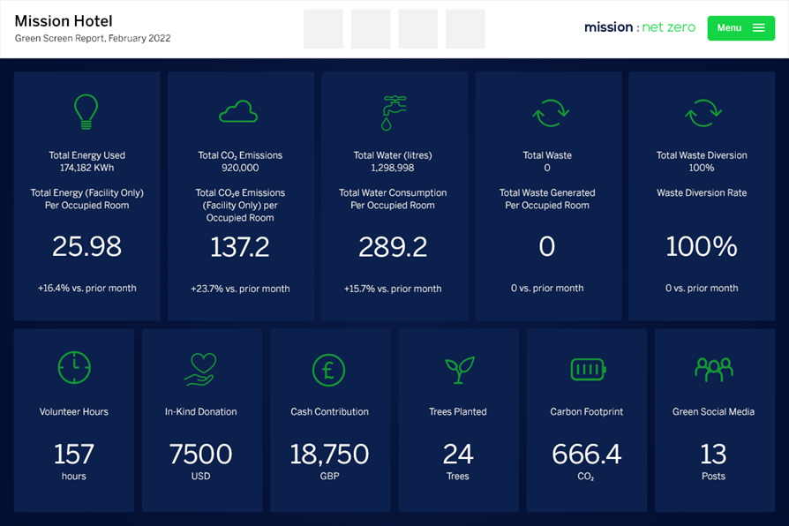
Green Screen - Monitoring, Managing ​and Reporting on ESG KPI’s
Recognising many hotels do not operate an ESG management system, mission : net zero can provide our Green Screen ESG management platform.​
Green Screen enables hotels to monitor sustainability data, track performance and progress over time, report activities in a transparent way, and improve the hotels sustainability performance.
The benefits include: ​
Manage environmental, social and people data in a single system​
Keep everything online in one place and have access to ESG data whenever and wherever​
Collect data across the individual assets or portfolios for ESG reporting​
Automatically calculate the carbon footprint with up-to-date emission factors​
Set and monitor sustainability goals​
Monitor goals with easy visualisation of progress and gaps​
Modify and advance targets over time to increase your impact and reduce risks​
Communicate progress and achievements
Green Screen: Your all-in-one ESG platform to track, manage, and prove sustainability progress –
strengthening compliance, reputation, and asset value across Manchester’s hospitality sector.

Slide 9
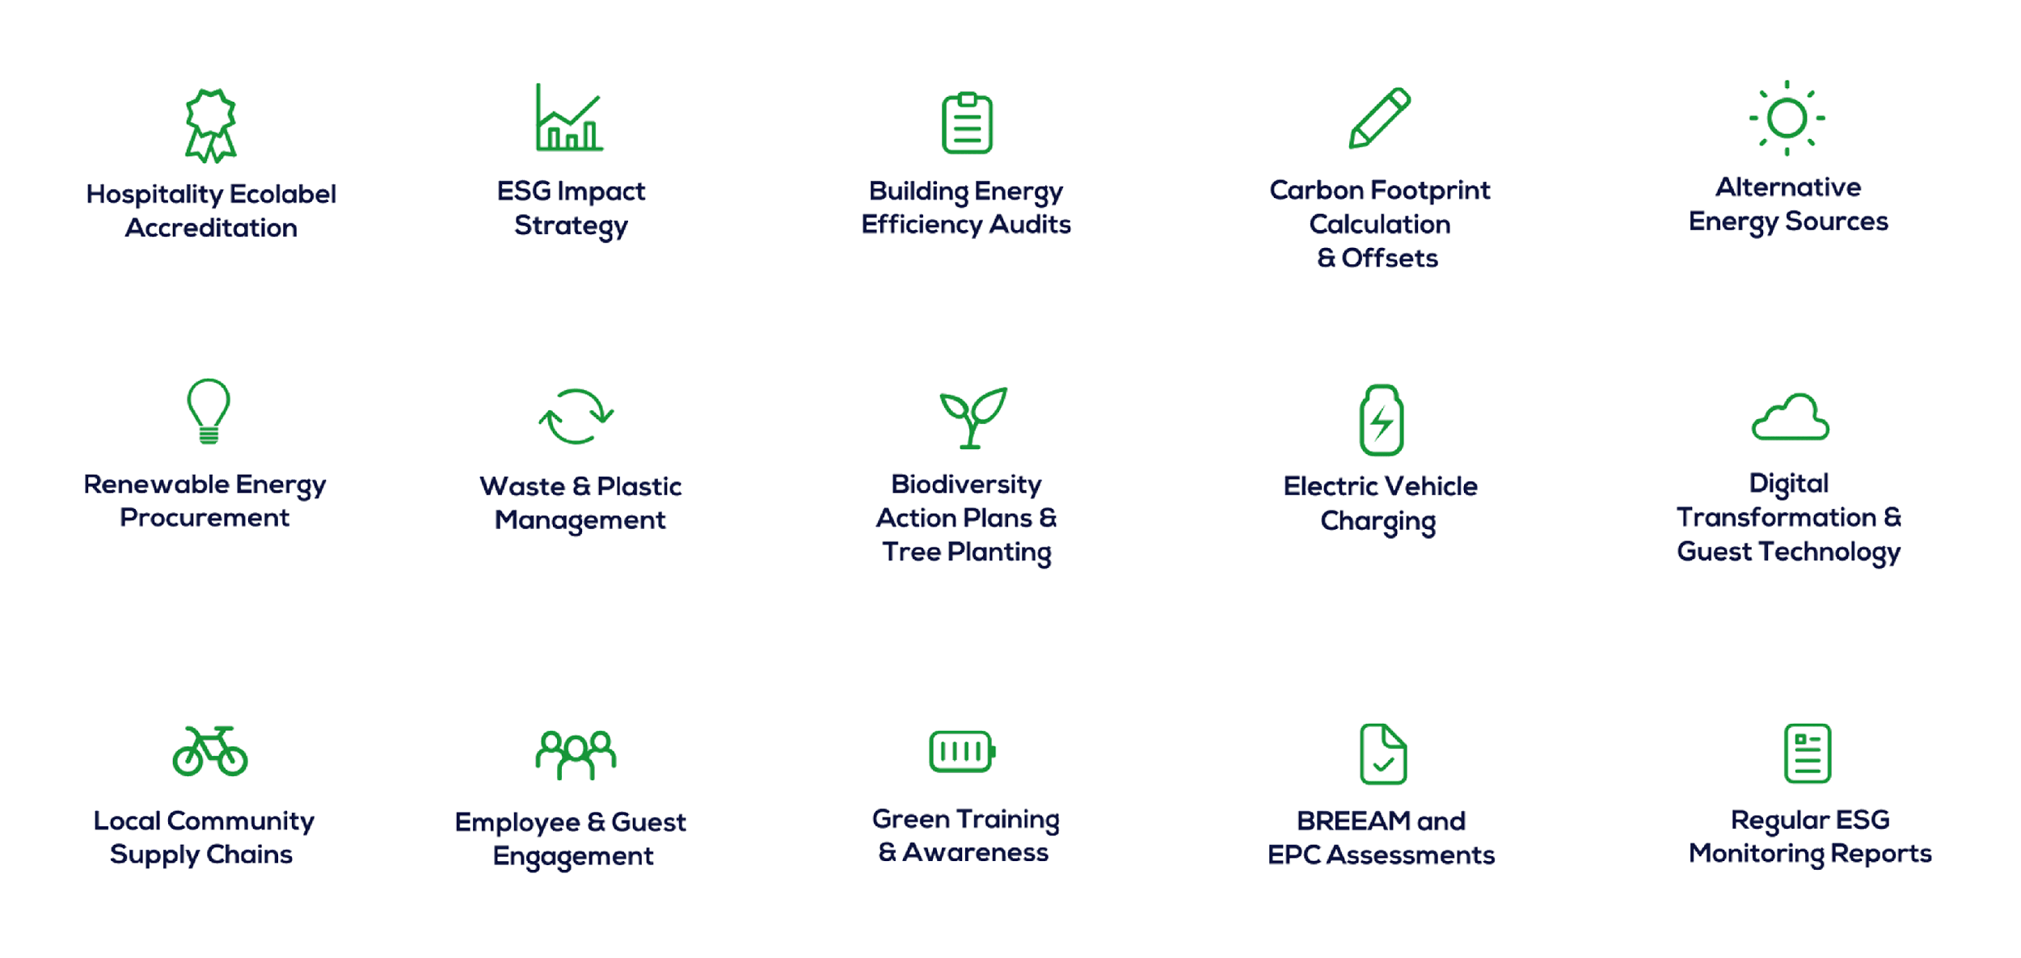
Other ESG Services for the Hospitality Sector

