Slide 1


Business Networking Event
A collaboration with Middlethorpe Hall

Slide 2

Introduction
Why are we doing this?
What will you do?
Why it is important that you are given the opportunity to be involved with this collaboration?

Slide 3
Meeting the team
Lionel Chatard – Director and General Manager of Middlethorpe Hall
Julia Betteridge – Conference and Banqueting Co-ordinator
Lionel and Julia will introduce themselves and explain what the project will involve for a logistical perspective

Slide 4
timeline
SEPT 2024
  Meet the Middlethorpe Team and launch the finer details of the event
July 2024
  In school launch
OCT 2024
  Weekly meetings to feedback details
NOV 2024
  Invites out and cold call
9th December 2024
  Business Network Event takes place at Middlethorpe Hall

Slide 5
Plan for launch
What roles are needed for the evening? Who is going to do these?
PLANNING
Meeting every Wednesday lunch to discuss progress
MARKETING
Team need to decide on who is generating the guest list – who to invite and why?
DESIGN
Team to design the invite. Need to liaise with Lionel as to what needs to be on.
Team to suggest canapes and to create these with the kitchen team
EVENT NIGHT
MENU

Slide 6
Weekly update
Marketing – guest list. Next steps.
Design – create invite based on criteria from Middlethorpe
Menu - feedback from kitchen team
Event night - roles?

Slide 7
Weekly update
Marketing – Phone calls/emails. Next steps.
Design – any tweaks following feedback from Middlethorpe?
Menu - feedback from kitchen team
Event night - create a list so Lionel can do job descriptions

Slide 8

Great work!
Invite has been converted to a jpeg and has been emailed out to all on your guest list. Middlethorpe are taking all RSVPs for you.
They have requested you target some specific people. See me for list and contact details.

Slide 9
Weekly update
Marketing – Guest list to create for sign in at the event.
Design – move on to room design/set up. Speak to Lionel about how to set up the room for the event
Menu - kitchen are cooking everything on the morning. We are assembling on the afternoon. Collect aprons from DT
Event night - who is meeting and greeting. 2 speakers to introduce and close the event.

Slide 10
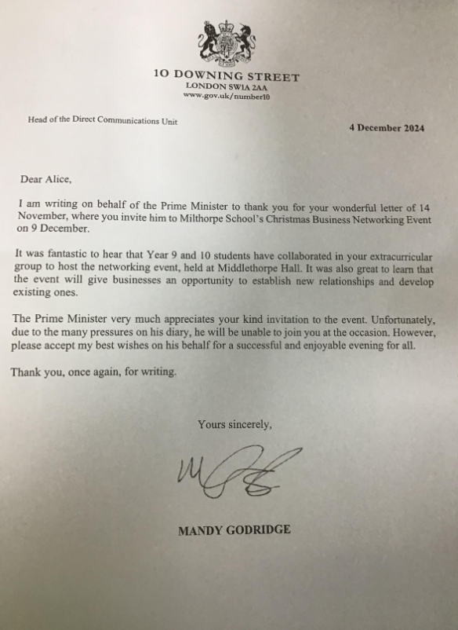
Apologies
We’ve had a lovely letter from Downing Street.
Unfortunately, the Prime Minister is unable to be your guest speaker. Do you have any other ideas?

Slide 11

Checklist
Invites accepted: Lord Mayor of York, Mayor of North Yorkshire and Town Crier have all accepted – exciting times!
Musicians invited and sorted
Consent forms returned. Meeting points arranged. 3.30pm for the set-up/canape team. Will pick the students involved in the school production up at 4.30pm
Dress code for the evening
Opening and closing speeches written and rehearsed
Final pre-event meet with Lionel and Julia
Good luck. You have all done an amazing job. You’’smash it!

Slide 12
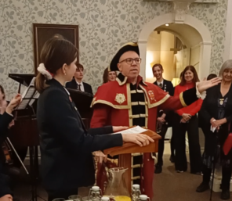
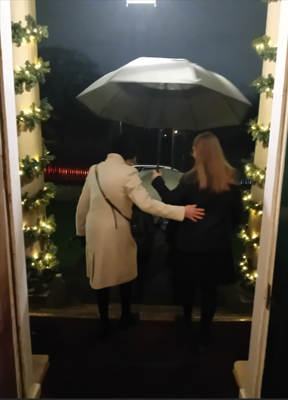
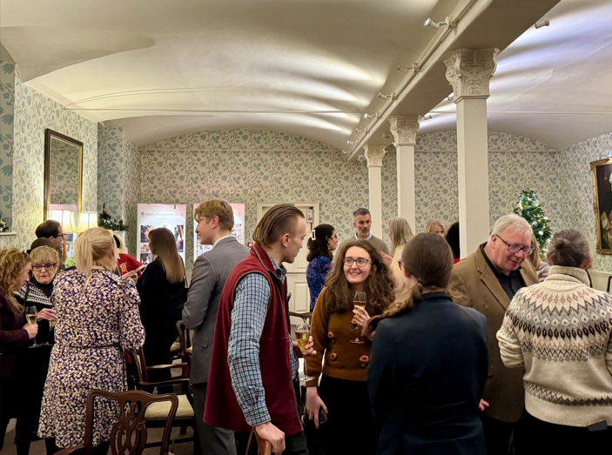
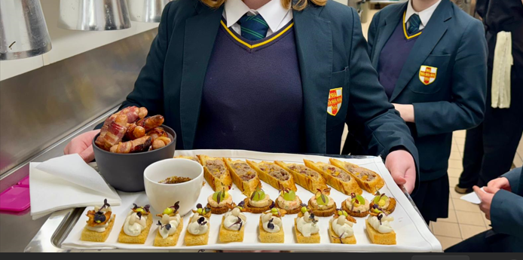
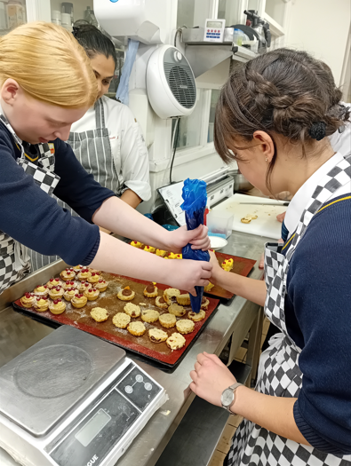
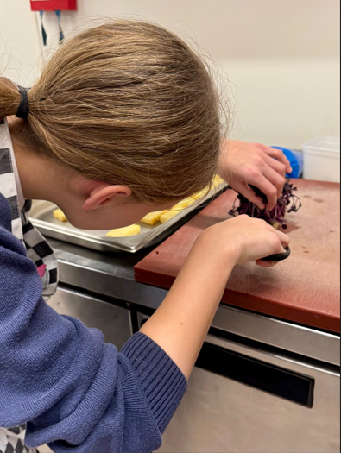
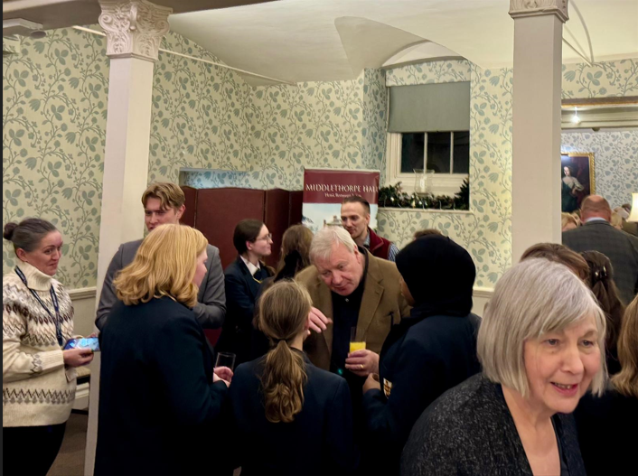
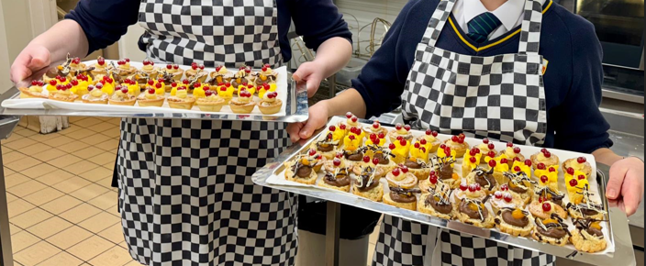
After the event
Lionel and Julia to feedback
Thank you to all at Middlethorpe for the most amazing experience.

