Slide 1


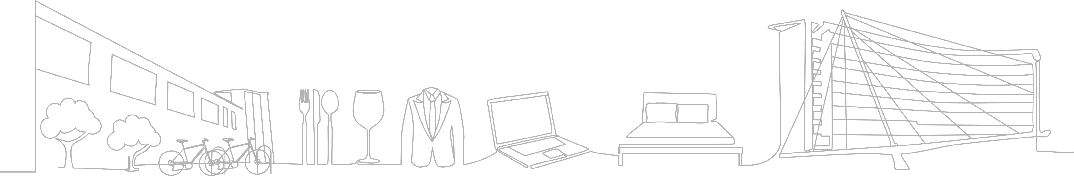
Guess the Garnish!
Facilitator notes (edit the presentation & delete this slide before presenting in class):
This is a short resource which ambassadors can use when delivering a talk or workshop in a school, to a Food Tech / Practical Cookery class. It is meant as a ‘warm up’ exercise and to get the class interacting with the speaker.
This activity could last 10-15mins depending on the audience engagement.
You can edit these slides to have your own restaurant / Chef’s presentation pictures / guides for presentation. We have added animation so that the answers show up, once you press ‘next’
Bring some hotel pens (or another prize) with you for the winning pair!

Slide 2
Guess the Garnish!
Get into pairs and grab a piece of paper
You are going to guess what garnish is used on the next 5 slides
Winning pair gets a special treat!

Slide 3
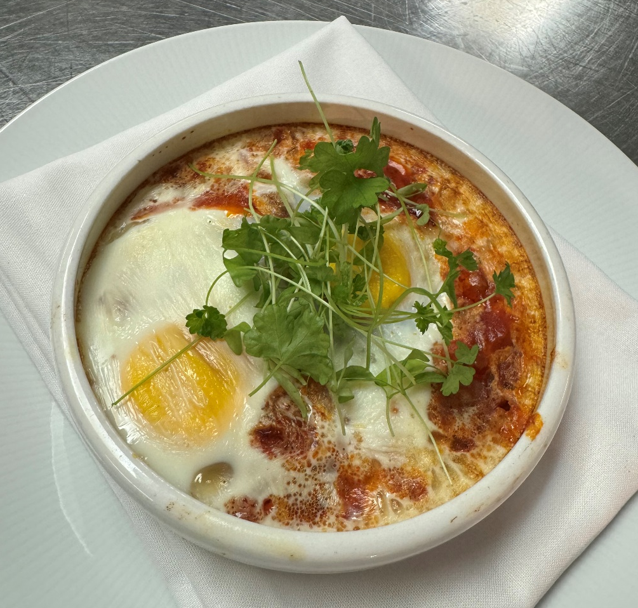
Can you guess the garnish used on the ‘Flamenco eggs’?
One point for every correctly identified garnish!

Slide 4
The answer is:
Micro parsley only!
One point for every correctly identified garnish!

Slide 5
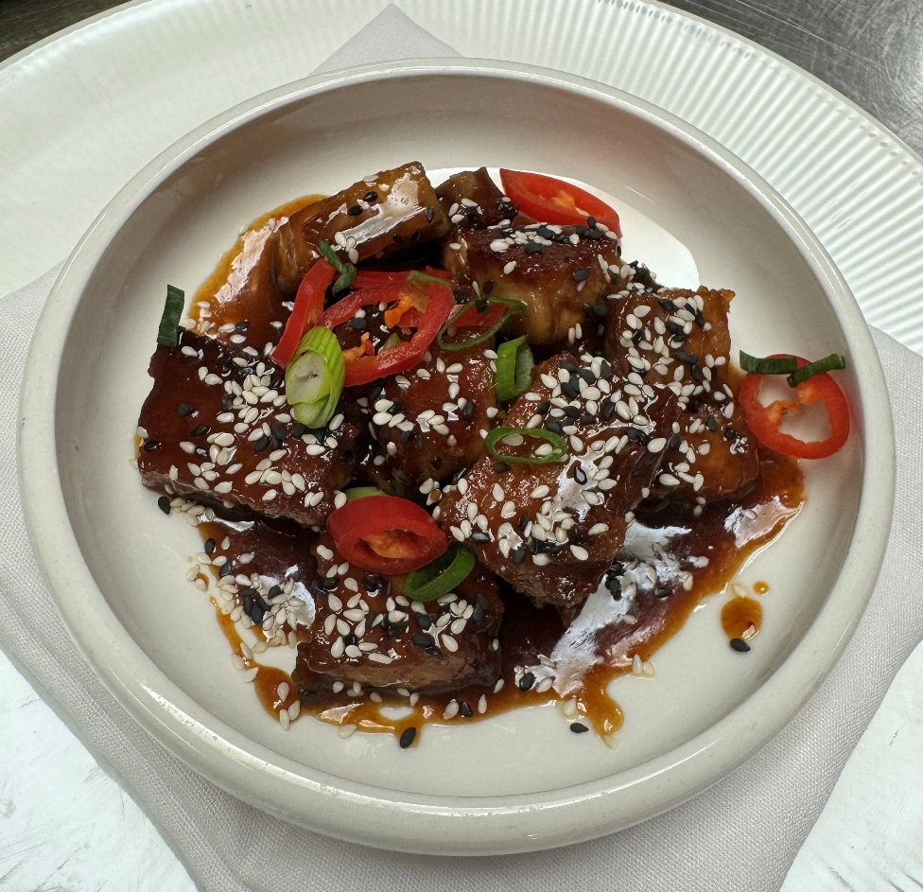
Can you guess the 3 garnishes used here on the ‘pork belly bites’?
One point for every correctly identified garnish!

Slide 6
The answer is:
Sesame seeds
Red sliced chilli
Spring onion
One point for every correctly identified garnish!

Slide 7
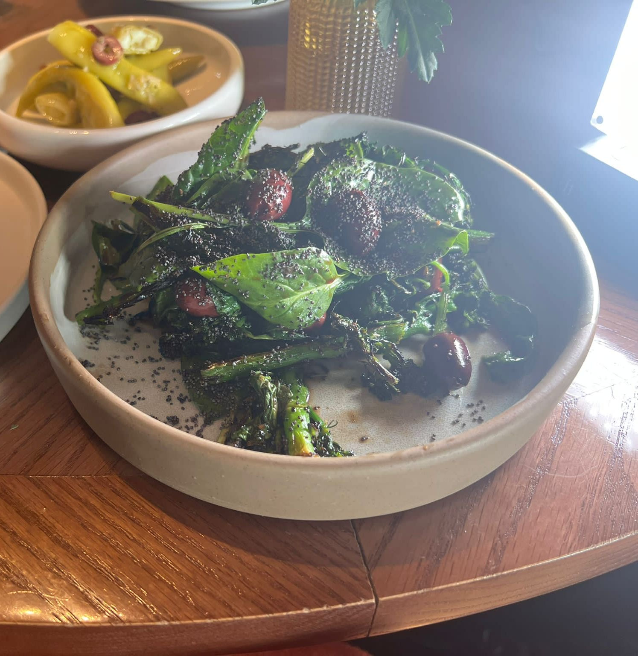
Can you guess the 3 garnishes used here on the broccoli salad?
One point for every correctly identified garnish!

Slide 8
The answer is:
Olives
Pomegranate molasses dressing
Poppy seeds
One point for every correctly identified garnish!

Slide 9
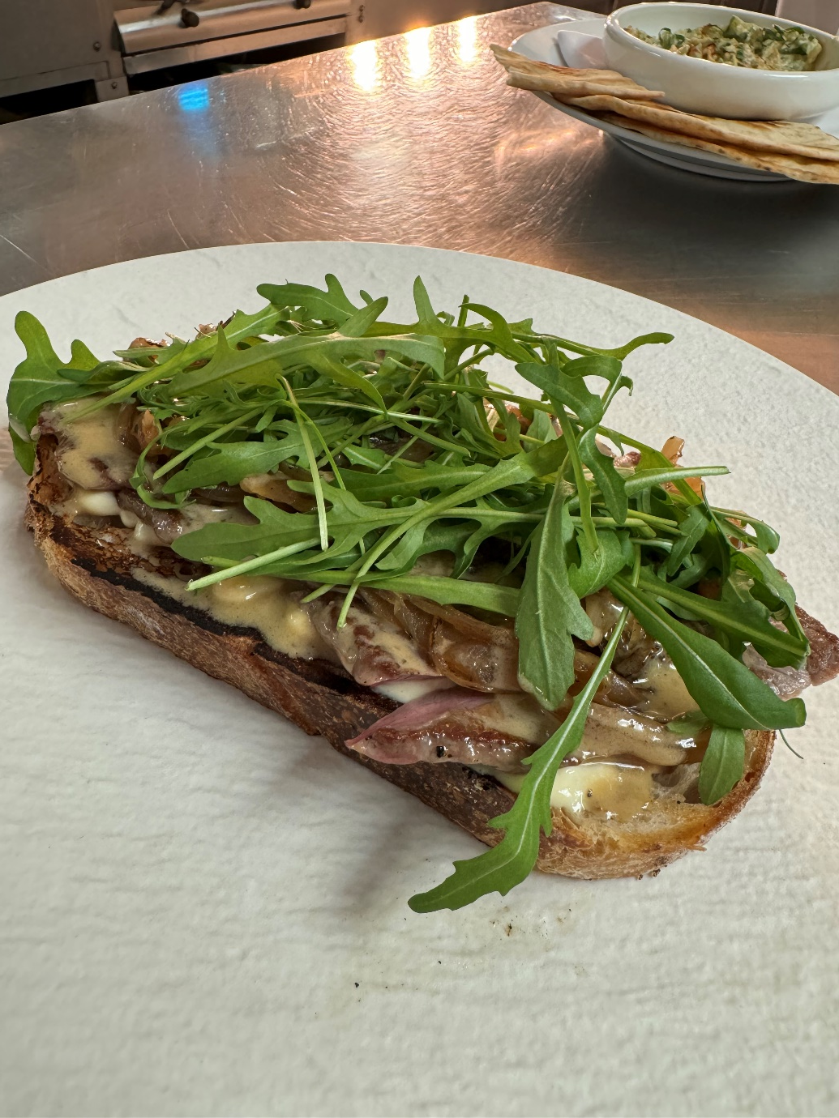
Can you guess the 3 garnishes used here on the steak sandwich?
One point for every correctly identified garnish!

Slide 10
The answer is:
Caramelised onion
Peppercorn sauce
Rocket leaf
One point for every correctly identified garnish!

Slide 11
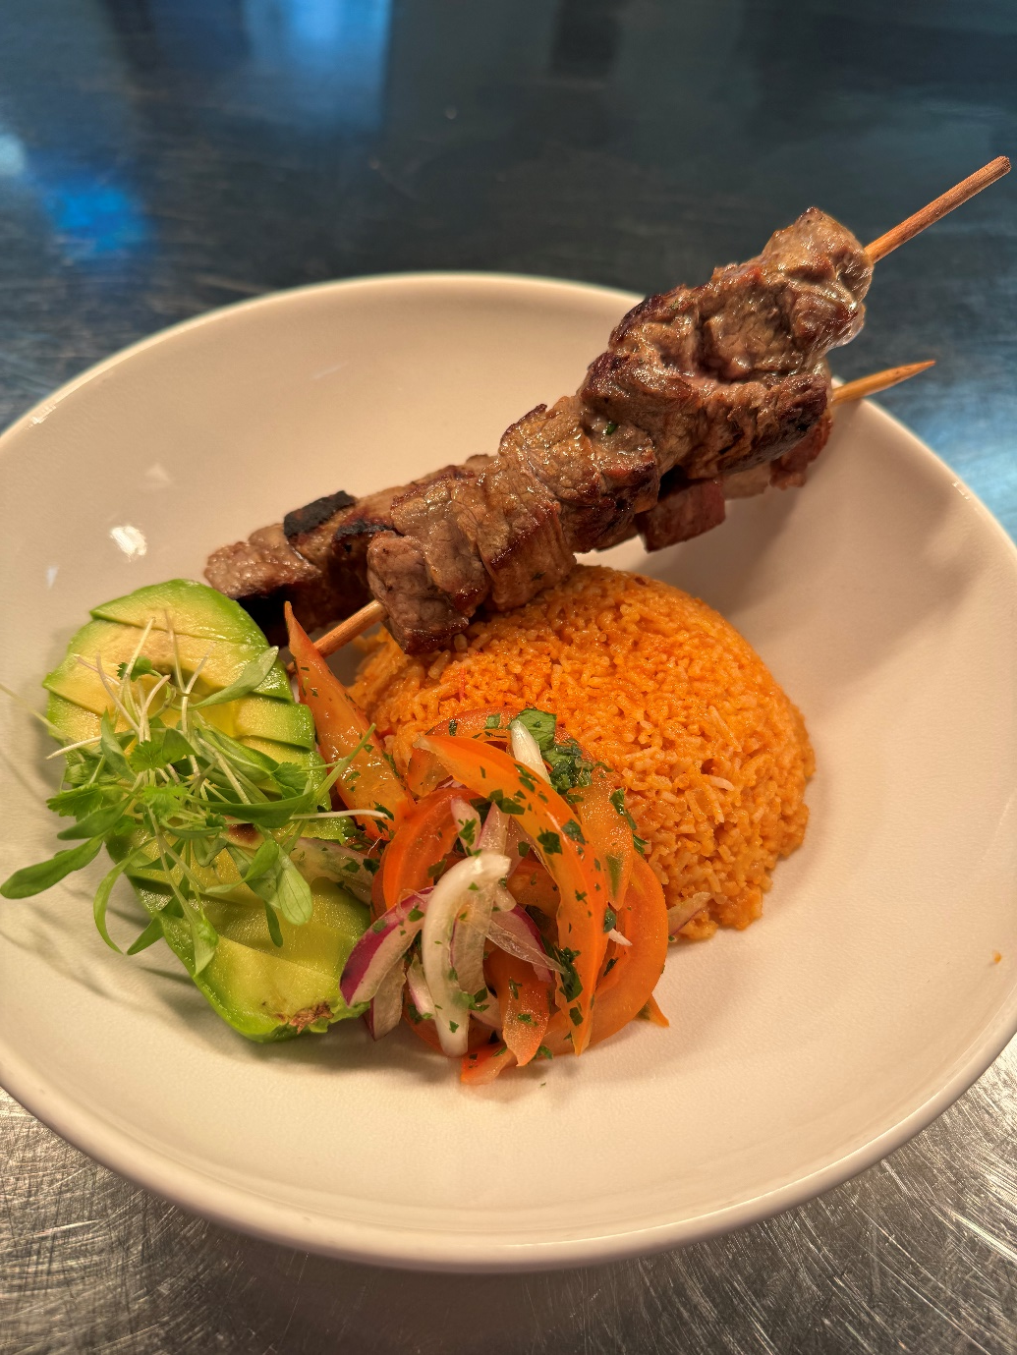
Can you guess the 4 garnishes used here with the beef skewer?
One point for every correctly identified garnish!

Slide 12
The answer is:
Mexican rice
Tomato and shallot salsa with chopped coriander
Avocado
Micro coriander
One point for every correctly identified garnish!

Slide 13

Who got the closest to 14 points?
Well done to our winning pair!

Slide 14
Any questions?

